Slide 1
A BLOCKCHAIN-BASED SECURE CLOUD FILES SHARING SCHEME WITH FINE-GRAINED ACCESS CONTROL
PROJECT GUIDE : MRS. DEEPA P
TEAM MEMBERS :
BAHADUR PRAVALLIKA(2018PECCS112)
DHANUSHA KARANAM(2018PECCS123)
SUNKESULA ELAHIN(2018PECCS217)
BATCH : A11
DOMAIN : BLOCKCHAIN

Slide 2

INTRODUCTION
Most software systems rely on cloud data storage for management of the data. With expeditious growth of digital world cloud storage has turned out into most reliable and convenient way of storing data. Data stored using cloud storage is stored in centralized manner.
A major advantage of traditional cloud storage is, it is not only easy to handle but also easy to access the data. The data stored on cloud storage can be easily accessed by number of devices at a time.
This way of storing data can cause single point failure, denial of service attack which may further lead to unavailability of data.
Developing a system with decentralized storage of data can definitely overcome problems like single point failure, data unavailability etc.
File uploaded on IPFS is stored in decentralized manner and cryptographic hash key returned by IPFS is stored on Ethereum Blockchain.
Further, only authenticated user can access that particular data on IPFS by successful decryption of cryptographic hash key stored on Blockchain.

Slide 3
LITERATURE SURVEY
AUTHORS | METHODOLOGY | TITLE
Sultan Almakdi , Brajendra Panda (2021) | Cybersecurity, Privacy-Preserving, Encrypted Databases, SQL Queries. | An Efficient Secure System for Fetching Data from the Outsourced Encrypted Databases.
Xiang Yu, Zhangxiang Shu, (2021) | BC-BLPM using Hyperledger Fabric. | A Multi-Level Security Access Control Model Based on Blockchain Technology
Jiyu Tao and Li Ling. (2021) | Attribute-based encryption, blockchain. | Medical Files Sharing Scheme Based on Blockchain and Decentralized Attribute-Based Encryption.
Ammar Battah (2020) | encrypted les, multi-party authority. | Blockchain-Based Multi-Party Authorization for Accessing IPFS Encrypted Data.
Moayad Aloqaily (2020) | Energy trade framework using smart contracts. | An Energy Trade Framework Using Smart Contracts: Overview and Challenges.
XIAOLIN FU (2020) | Block-chain, large grid | Decentralized Access Control for IoT Data Using Blockchain and Trusted Oracles
H. Albreiki (2019) | trusted oracles, IoT data | Research on Block-Chain-Based Intelligent Transaction and Collaborative Scheduling Strategies for Large Grid.
Nurzhan Zhumabekuly Aitzhan (2019) | smart grid systems | Security and Privacy in Decentralized Energy Trading through Multi-Signatures, Blockchain and Anonymous Messaging Streams
K. Salah (2019) | block chain, Smart Contracts | Blockchain-based Soybean Traceability in Agricultural Supply Chain.
RUIGUO YU(2017) | block chain, hash encryption | Authentication With Block-Chain Algorithm and Text Encryption Protocol in Calculation of Social Network.

Slide 4
PROBLEM DEFINITION
Most software systems rely on cloud data storage for management of the data.It is the most reliable and convenient way of storing data. Data stored using cloud storage is stored in centralized manner.
A major advantage of traditional cloud storage is, it is not only easy to handle but also easy to access the data. The data stored on cloud storage can be easily accessed by number of devices at a time.
This way of storing data can cause single point failure, denial of service attack which may further lead to unavailability of data.
Developing a system with decentralized storage of data can definitely overcome problems like single point failure, data unavailability etc.
File uploaded on IPFS is stored in decentralized manner and cryptographic hash key returned by IPFS is stored on Ethereum Blockchain.
Further, only authenticated user can access that particular data on IPFS by successful decryption of cryptographic hash key stored on Blockchain.

Slide 5
DEVELOPMENT ENVIRONMENT
SOFTWARE ENVIRONMENT:
Flask
HTML5 , CSS , BOOTSTRAP 3
Python 3
HARDWARE ENVIRONMENT:
2 GB RAM
80 GB Hard Disk
Above 2GHz Processor

Slide 6
SYSTEM ARCHITECTURE

Slide 7
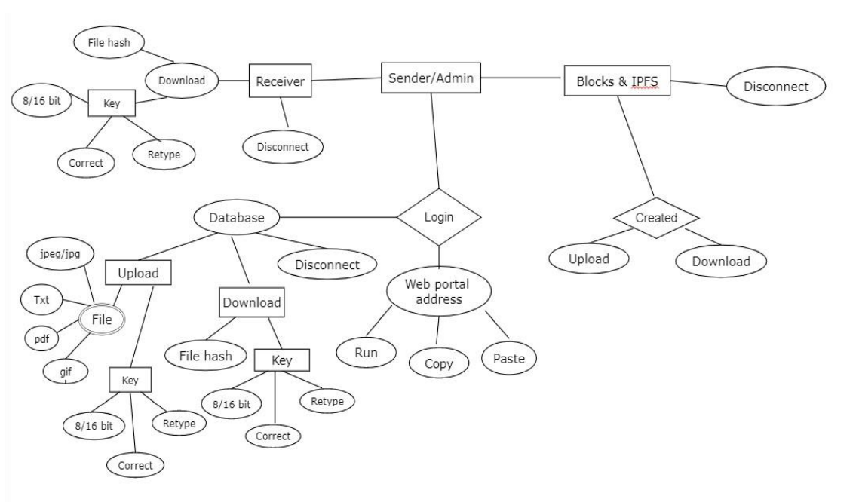
ER DIAGRAM

Slide 8
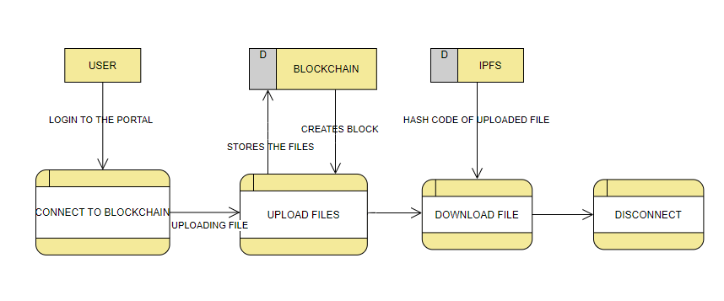
DATAFLOW DIAGRAM

Slide 9
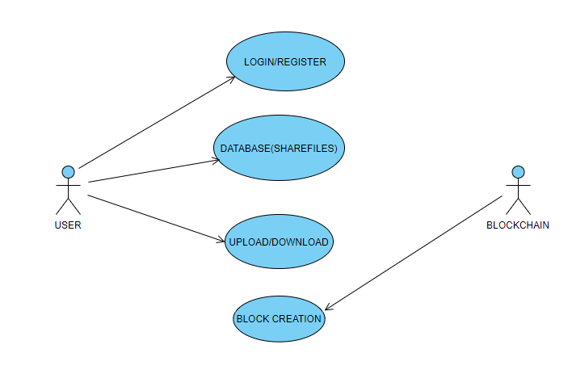
USECASE DIAGRAM

Slide 10
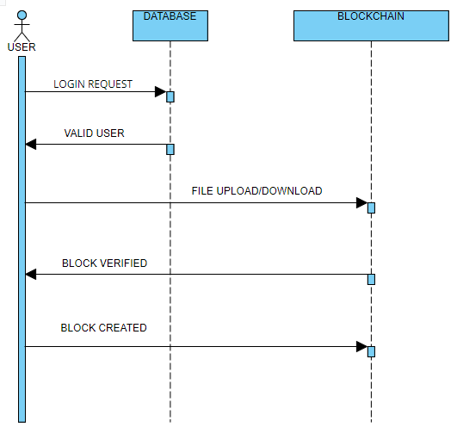
SEQUENCE DIAGRAM

Slide 11
MODULE DESCRIPTION
Blockchain
Peer to Peer Network
AES
Interplanetary File System

Slide 12
BLOCKCHAIN
In the proposed system, Blockchain is used for authentication of users as well as to ensure integrity of data.
As there are number of blocks in Blockchain connected with each other in a chain like structure Blockchain is called as Immutable way of storing data.

Slide 13
\PEER TO PEER NETWORK
In order to create a peer to peer network (p2p) for the Blockchain to function, all the connected nodes must be in the same network.
Only those users who are connected to the block chain's p2p network should have access to the block chain's data.
This p2p network is created using Socket Programming.
We are working on a permissioned block chains which require access to be a part of the Blockchain.

Slide 14
ADVANCED ENCRYPTION STANDARD
We use the AES algorithm to generate a unique hash of the entire block that is used by the corresponding blocks to form the chain (via the previous hashes).
IPFS as well uses this algorithm to generate the hash of the shared file.

Slide 15
INTERPLANETARY FILE SYSTEN
Our Blockchain relies on IPFS for keeping it lightweight and scalable.
If the files were stored directly on the Blockchain, it would render the Blockchain very heavy and inefficient.
Combining IPFS and Blockchain, we get to access the IPFS’s power of decentralized storage and enhance the block chain's security and accessibility.
Instead of storing the file directly on the Blockchain, we store the files on the IPFS network while the Blockchain stores only the file’ hash

Slide 16
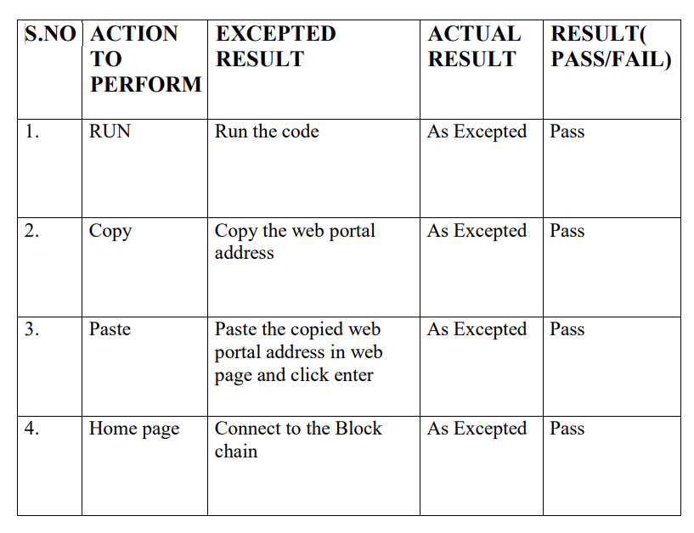
TEST CASES & REPORT
LOGIN

Slide 17
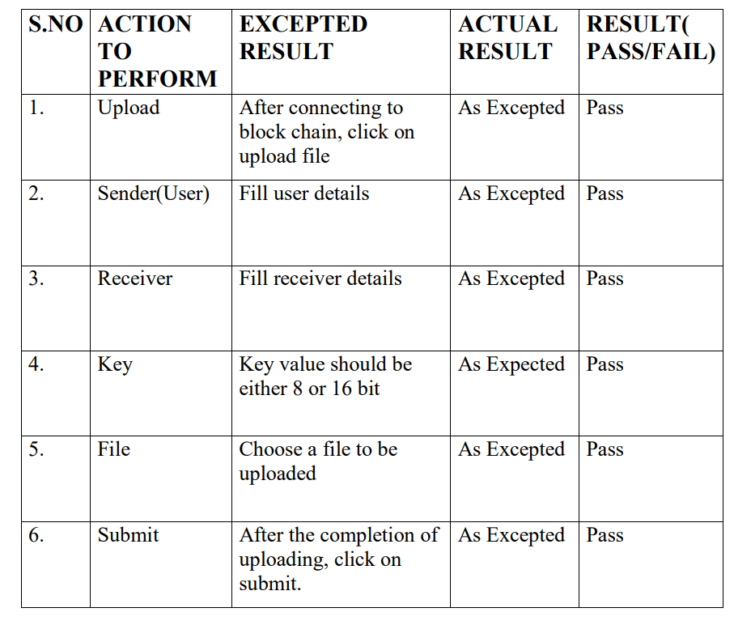
UPLOAD FILE

Slide 18
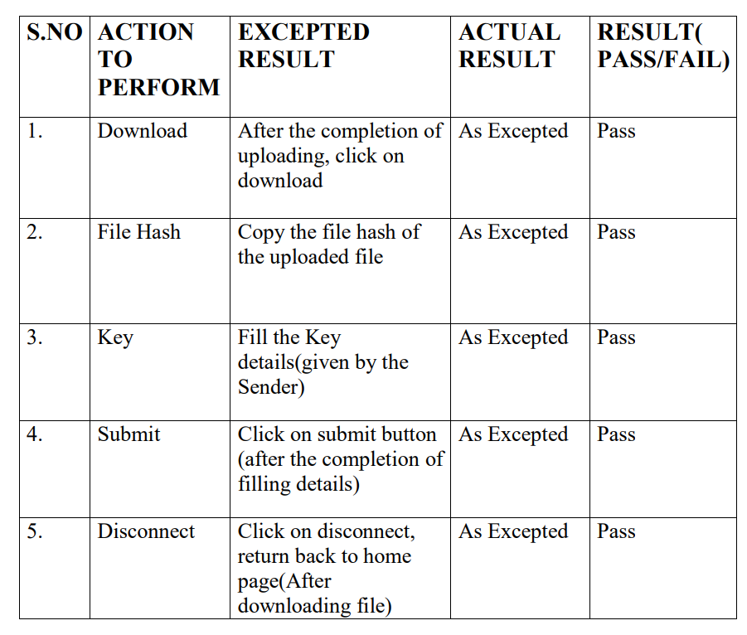
DOWNLOAD FILE

Slide 19
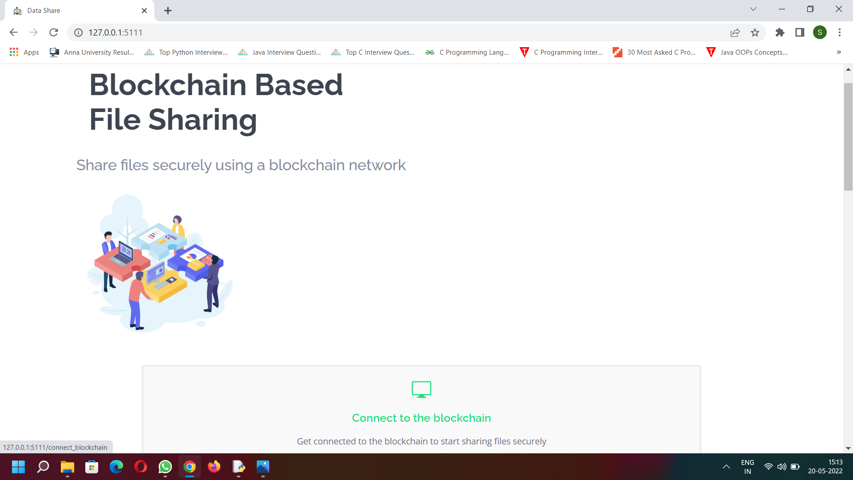
SCREENSHOTS
HOME PAGE

Slide 20
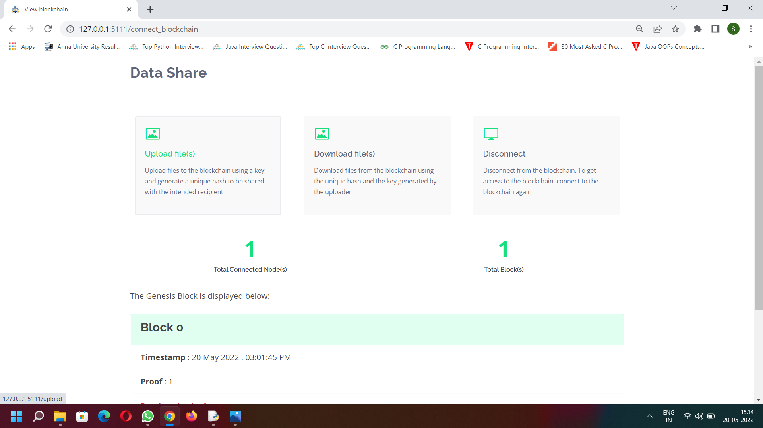
DATA SHARING PAGE

Slide 21
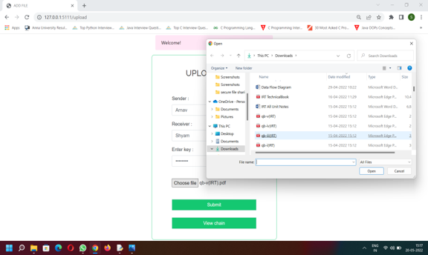
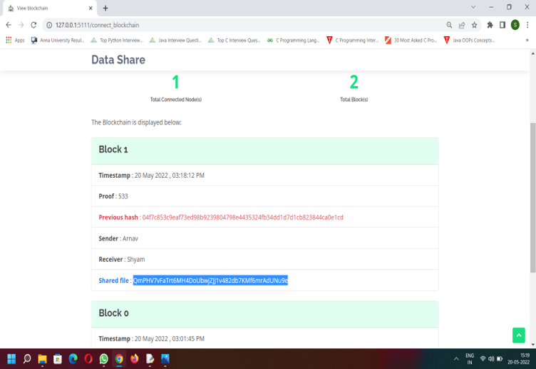
UPLOAD & BLOCK CREATION

Slide 22
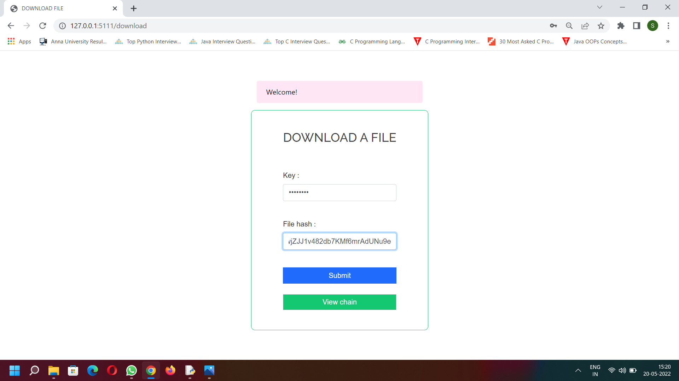
DOWNLOAD FILE

Slide 23
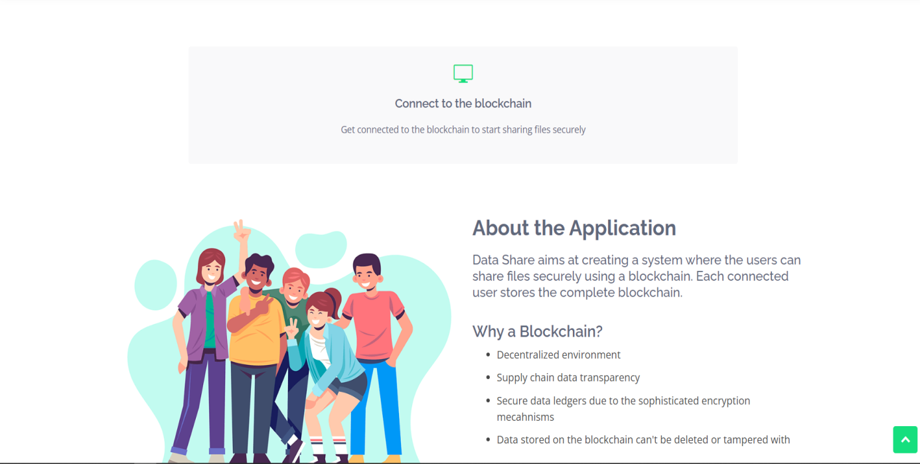
DISCONNECT & RETURN TO HOMEPAGE

Slide 24
CONCLUSION
This project proposes the design and architecture of an advanced as well as secured web application for storing and sharing the data. A simple, affordable, easy to use and most secured system is proposed to solve the data security issues like integrity, authenticity and data unavailability.

Slide 25
REFERENCES
Sultan Almakdi ,Brajendra Panda , Mohammed Alshehri, and AbdulwahabAlazeb. “An Efficient Secure System for Fetching Data from the Outsourced Encrypted Databases”, 2021.
Xiang Yu, Zhangxiang Shu, Qiang Li, Jun Huang.“ A Multi-Level Security Access Control Model Based on Blockchain Technology”, 2021.
H.Albreiki, L. Alqassem, K. Salah, M. H. Rehman, D. Svetinovic. “Decentralized Access Control for IoT Data Using Blockchain and Trusted Oracles”,2019.
Nurzhan ZhumabekulyAitzhan and Davor Svetinovic. “Security Privacy in Decentralized Energy Trading through Multi -Signatures, Blockchain and Anonymous Messaging Streams, 2019.
K. Salah, N. Nizamuddin, R. Jayaraman and M. Omar. “Blockchain-based Soybean Traceability in Agricultural Supply Chain, 2019.
RUIGUO YU1, JIANRONG WANG, TIANYI XU, JIE GAO,YONGLI,“Authentication with
Block-Chain Algorithm and Text Encryption Protocol inCalculation of Social Network. 2017.

